Slide 1
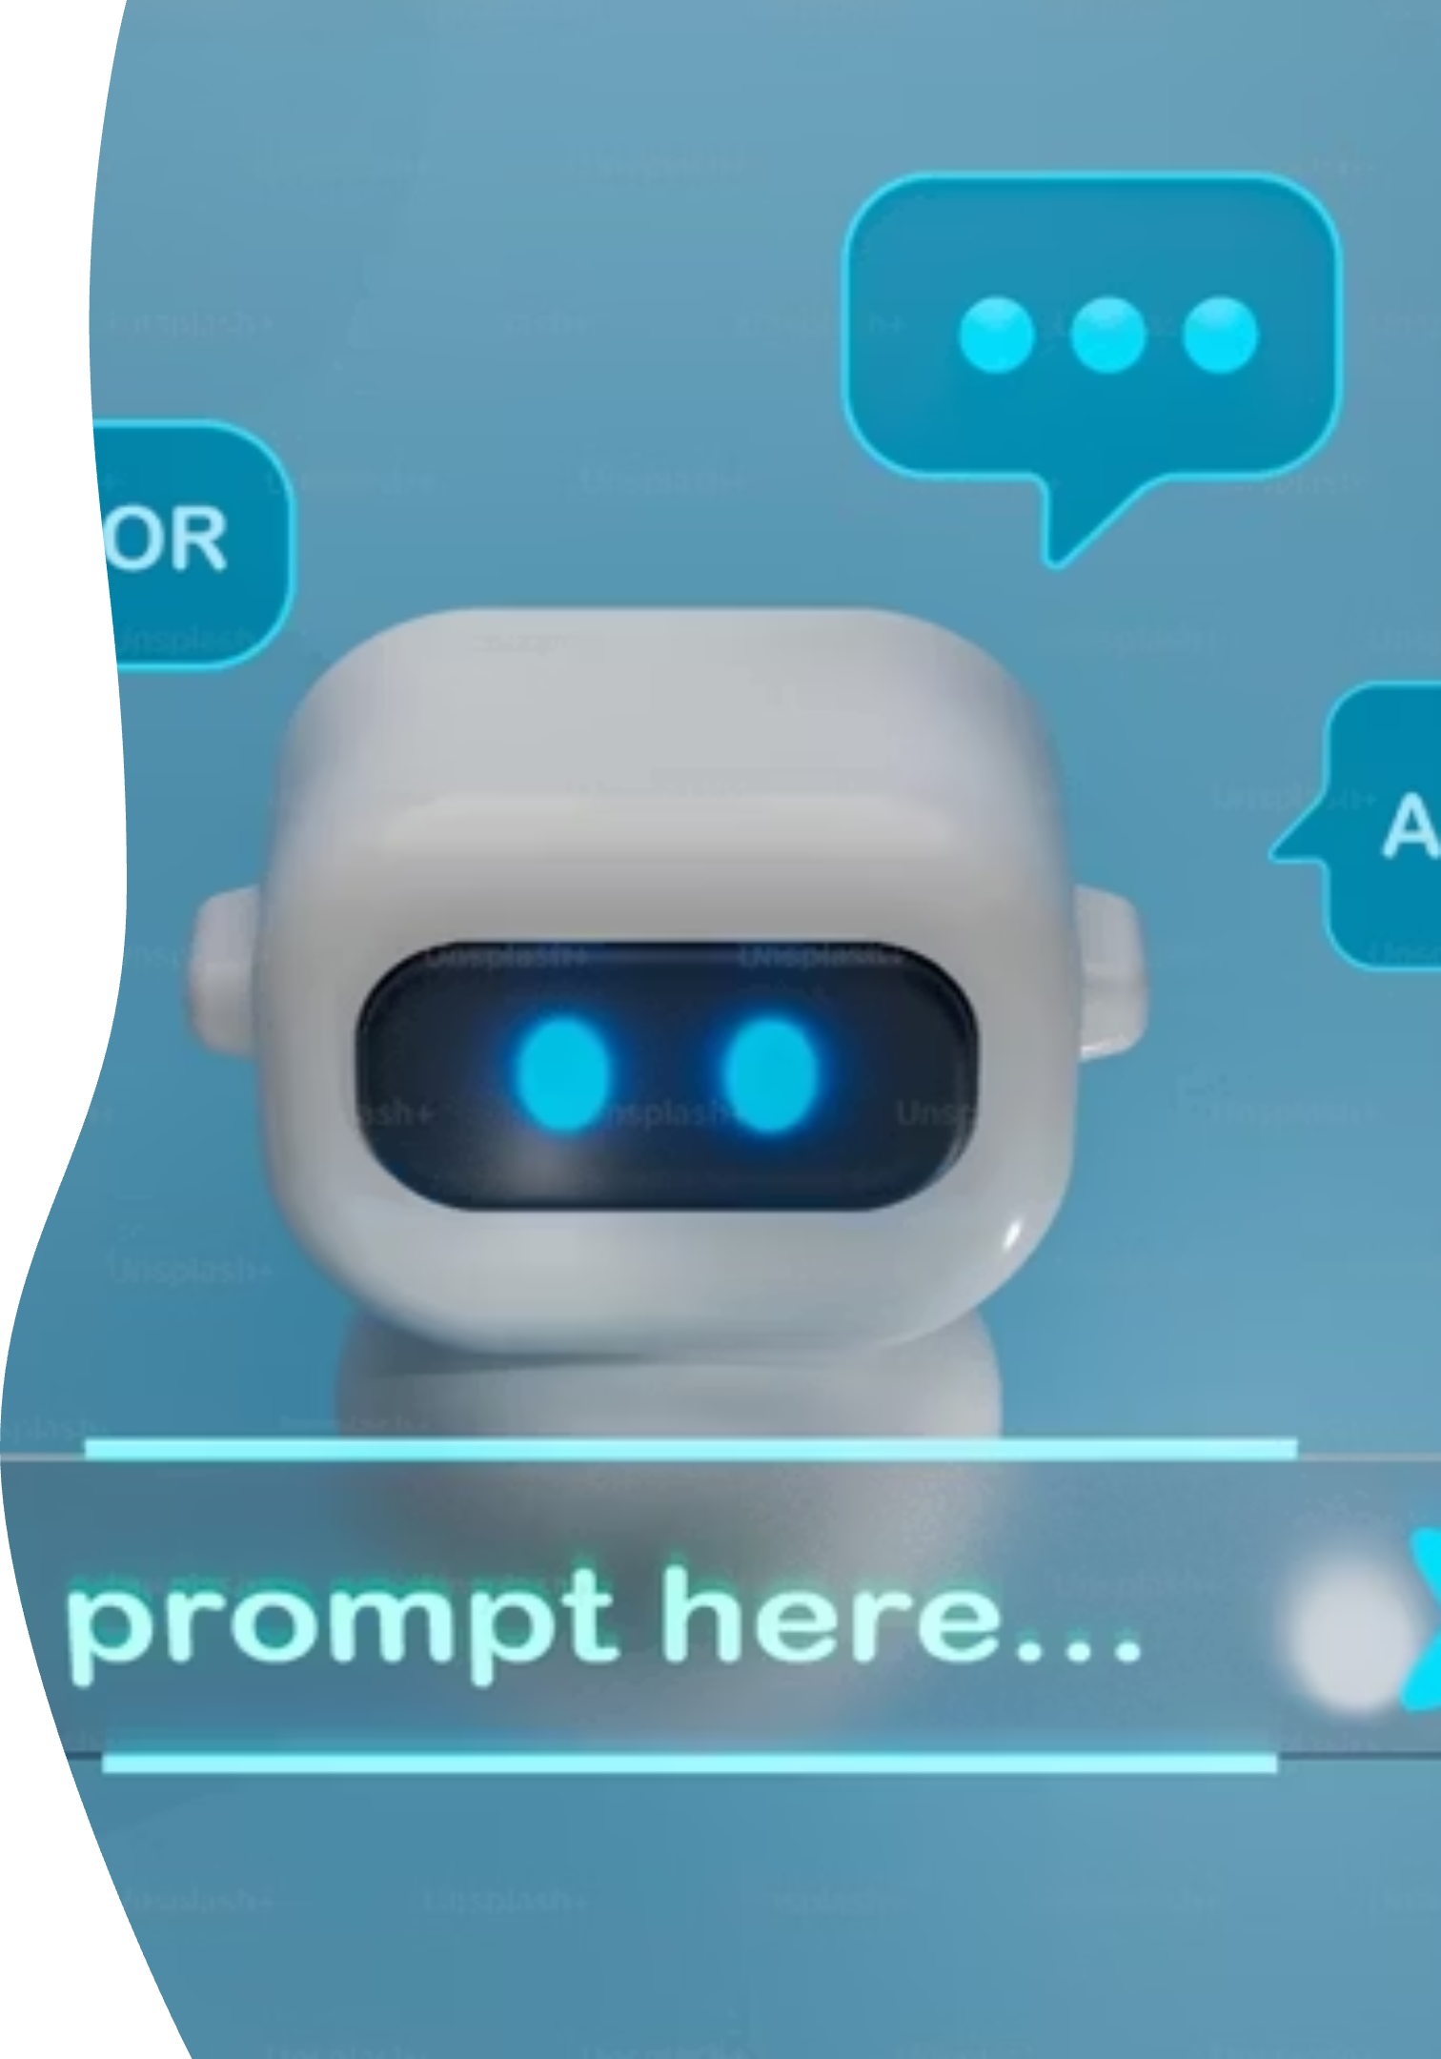
AI Assistant :
A Prompt Engineering Based Interactive Assistant
Name : Devika N D
Email id : devikashetty2716@gmail.com
AICTE id : STU67fca08f8d7131744609423

Slide 2

Introduction
Transforming Human-Knowledge Interaction
Demonstration Project
Multi-Functional Capabilities
This project demonstrates an AI Assistant built using prompt engineering
AI is changing how humans interact with knowledge
Assistant can answer, summarize, create, and advise

Slide 3
Objectives
1
2
Multi-Functional AI
User-Friendly Interface
Build a multi-functional AI Assistant
Provide user-friendly interaction (Flask Web App)
3
4
Prompt Flexibility
Continuous Improvement
Implement different prompt styles for flexibility
Collect feedback for improvements

Slide 4
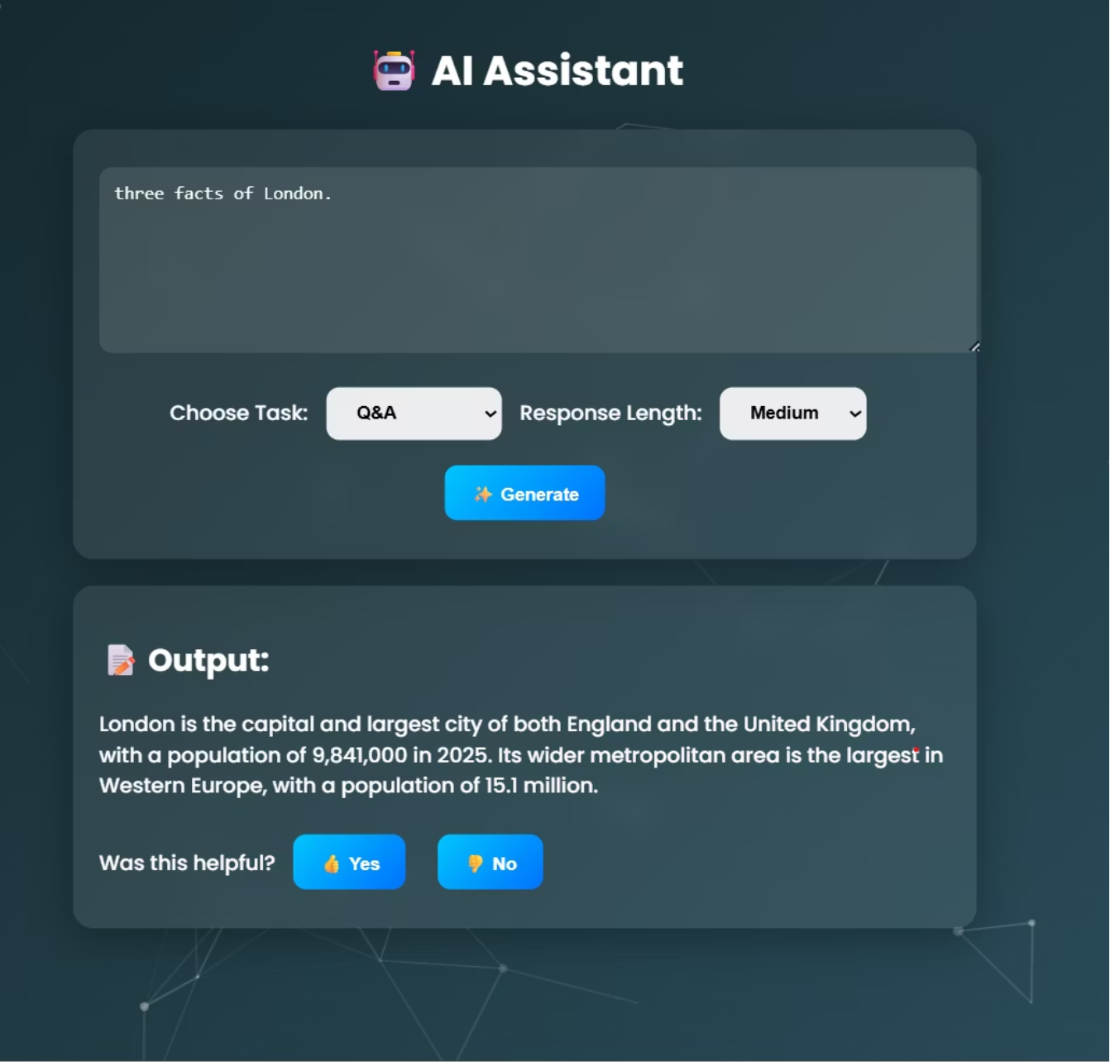





Tools & Technologies
Backend
Python 3, Flask
Frontend
HTML, CSS, JS for frontend
Visual Effects
Particles.js for animated background
Libraries
wikipedia, jinja2
Data Storage
Feedback stored in text file

Slide 5





Features
Q&A
Summarizer
Creative Generator
Factual answers
Short, medium, long summaries
Stories, poems, narratives
Advice Mode
Feedback Loop
Tips and step-by-step guidance
Thumbs up/down for improvements

Slide 6
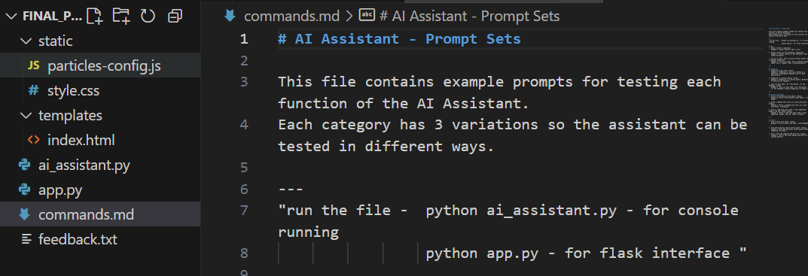




System Design
Frontend
Flask + HTML/CSS + Particles.js
Backend
Python logic + Wikipedia API
Files
app.py → main app
templates/index.html → UI
static/style.css, particles-config.js → styling
commands.md → prompt sets
feedback.txt → user feedback

Slide 7
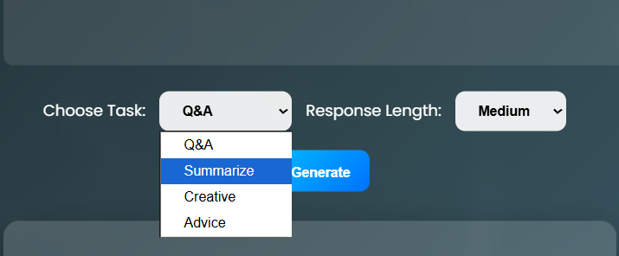

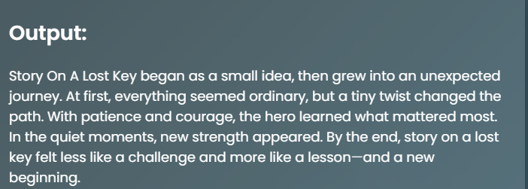
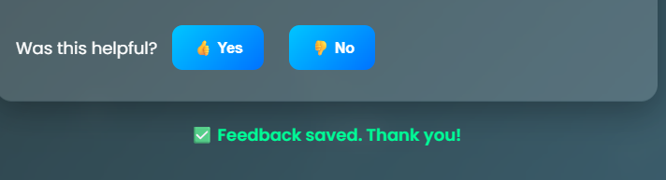
Demo Screenshots
Home Page
Home page with particle background
Task Selection
Dropdown options for tasks
Generated Output
Example generated output
User Feedback
Feedback buttons

Slide 8
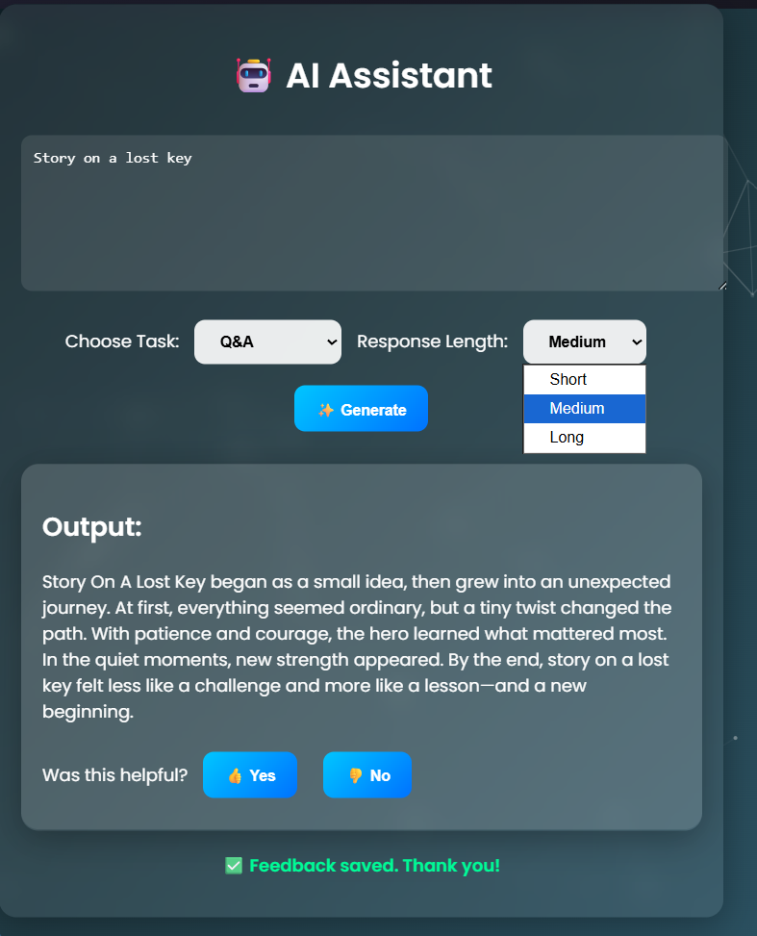

Challenges Faced
Python Version Conflicts
Multiple Python versions conflict (3.10 vs 3.13)
Installation Issues
Installing Flask & libraries
UI Design Complexity
Designing modern UI with glassmorphism + particles
Prompt Engineering
Tuning prompts for varied responses

Slide 9

Learnings & Conclusion
Skills Acquired
Project Outcome
project link :
https://github.com/Devika2605/vaultofcodes/tree/main/Final%20project
All assignment link : https://github.com/Devika2605/vaultofcodes
Learned prompt engineering techniques
Delivered an end-to-end AI Assistant project
Gained experience in Flask web development
Improved UI/UX design skills
Future Scope
Voice input
Memory
Better API integration

